Slide 1
UB emergency Planning and Coordination
Presentation to Faculty Senate Executive Committee

Slide 2
UB uses a collaborative approach to campus safety
EH & S is called in by the on scene supervisor when appropriate
Emergency Management is activated in larger scale events or events that may have a significant or long term impact.
Training and planning in advance is done with UPD, EH & S and Emergency Management
UPD has MOUs with NYS Police, BPD, and APD
University Communications manages information
UB Incident Management Team is activated to coordinate response strategies

Slide 3
UB Emergency Management
Comprehensive Emergency Management Plan (CEMP):
All hazards, phases, stakeholders, and impacts of incidents and emergencies
UB Incident Management Team activations
Specialized planning for unique hazards and vulnerabilities
Continuity plans
Departmental level plans
Warning and Notification
Policies for EM Program, Change in Scheduled Operations, Essential Personnel

Slide 4
University Police
58 sworn police officers
44 Patrol Officers
5 Investigators
9 Lieutenants
3 Administrators

Slide 5
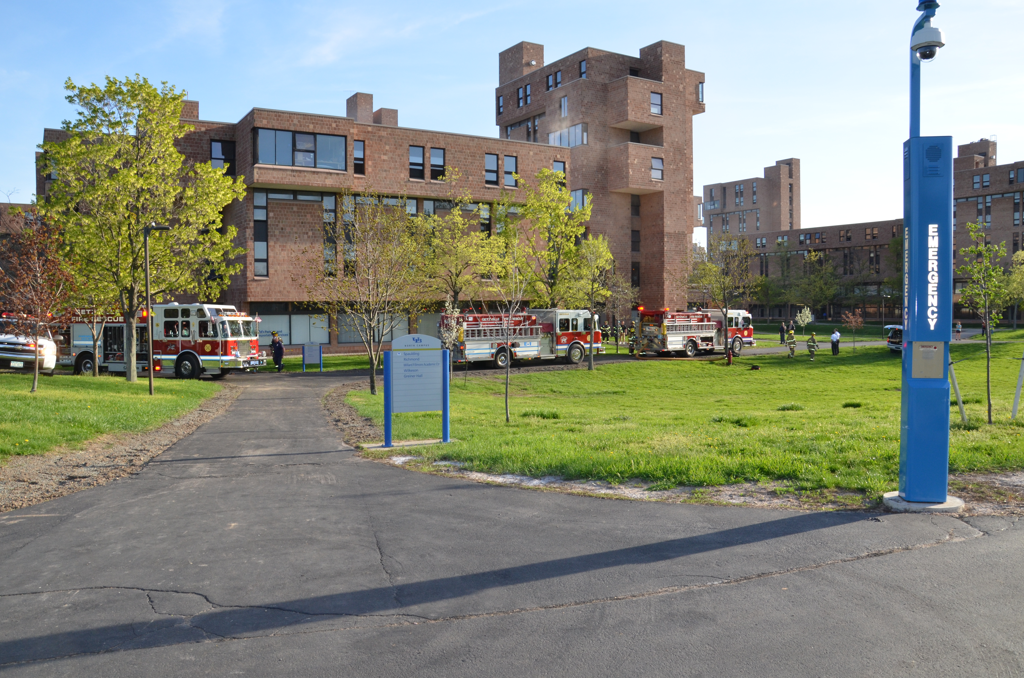
Notes:
Offenses Cts Law Sect. Sub Sect. Class Cat Deg NCIC MS Att
1 PL 150.05 01 E F 4 2099 MS N
ARSON-4TH:RECKLESSLY DAMAGE
1 PL 145.00 03 A M 4 2999 N
CRIM MIS:RCKLS PROP DAM > $250
1 PL 145.25 B M 0 2999 N
RECKLESS ENDANGERMENT PROPERTY
1 PL 221.05 V 0 3562 N
UNLAWFUL POSSESSION MARIHUANA

Slide 6
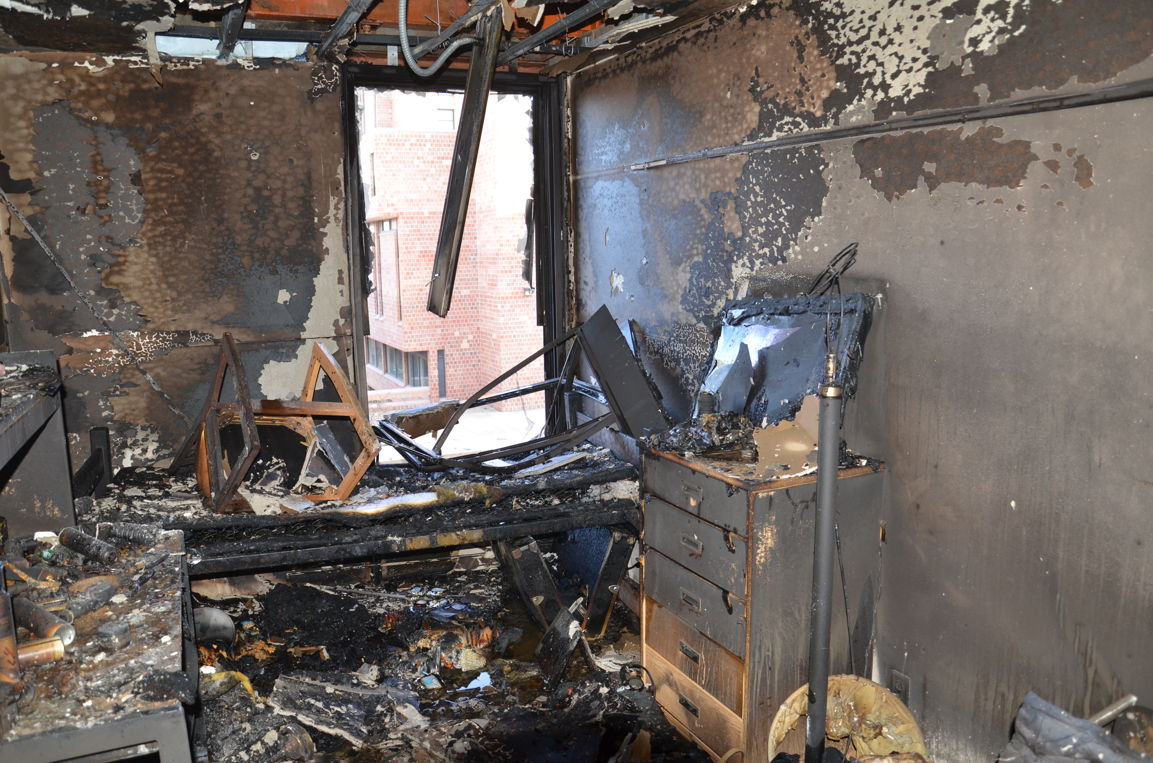

Slide 7
UB Environment, Health and Safety (EH&S) Emergency Planning
Building Fire Prevention and Evacuation Plans (BFPEP)
Required evacuation drills
Facilitate evacuations and assembly areas
Areas of Safe Refuge
Hazardous Materials Security
Chemicals, Radioactive Materials and Biological Materials
Hazardous waste storage areas
Controlled substances
Shipping
EH&S Laboratory Inspections
Annual Fire Code Inspections
UB EH&S Hazardous Materials Response Team & IMT Participation

Slide 8
University Communications Responsible for Crisis Communications
During a Crisis, University Communications will:
Develop the university’s official messages
Notify key audiences of the incident in coordination with the Incident Commander
Coordinate the distribution of essential information to students, faculty, staff and other
Issue the university’s first public/statement as well as periodic updates
Identify and prepare official UB spokespersons
Manage the university’s interactions with the news media

Slide 9
University Communications Crisis Communications Team
The team consists of designated, trained staff within University Communications:
Public Information Officer (PIO) responsible for developing official information about the emergency in coordination with Incident Commander
Operations group uses confirmed facts and messages approved by the PIO to prepare communications
Information dissemination group communicates official messages to internal and external audiences
Media relations group is proactive and reactive with the news media
Logistics group supports the work of the other groups in the team

Slide 10
Questions?

